Slide 1
Flutter App Development Summer
By:
Edward Victorhez
iOS, Android, Windows and Web developer.
Google GADS 2020 Android Mentor.
Mobile developer DanoZone Digital Services.
Dano Boot Camp
www.danobootcamp.com

Slide 2
Our world has never failed to furnish new technology when it comes to evolution. Technological advancement leads our globe into a new dimension. No one will refuse the fact that Google pays huge contribution in this advancement. Google never disappoints to offer their service when it comes to technological enhancement with lot of new inventions every now and then. Their inventions never fails to make an impact in these modern days.
Dano Boot Camp
www.danobootcamp.com

Slide 3

Victorhez
www.danobootcamp.com
Dano Boot Camp
www.danobootcamp.com

Slide 4
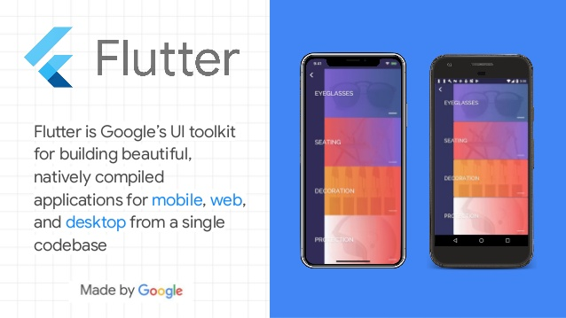
Overview
Dano Boot Camp
www.danobootcamp.com

Slide 5
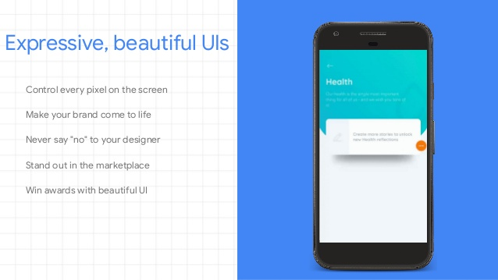
Dano Boot Camp
www.danobootcamp.com

Slide 6
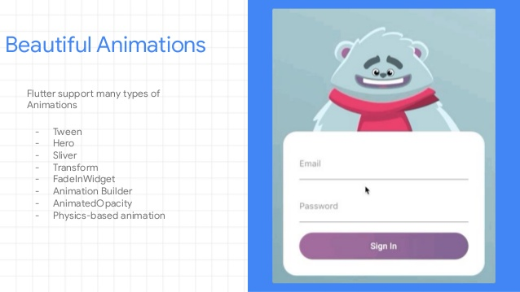
Dano Boot Camp
www.danobootcamp.com

Slide 7
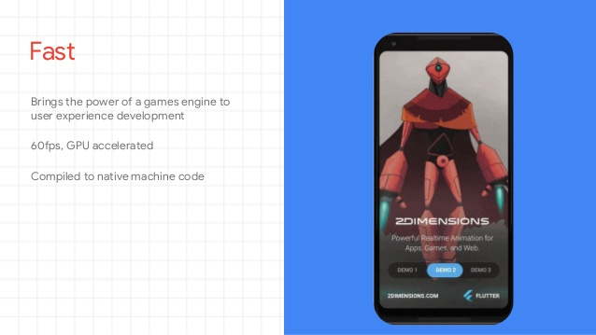
Dano Boot Camp
www.danobootcamp.com

Slide 8
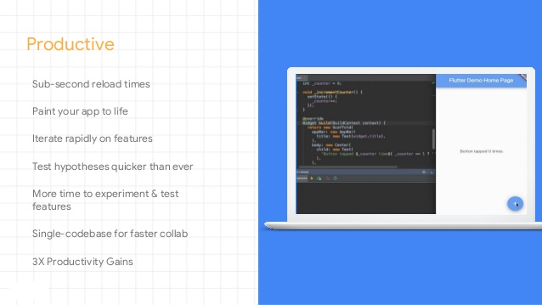
Dano Boot Camp
www.danobootcamp.com

Slide 9

Dano Boot Camp
www.danobootcamp.com

Slide 10
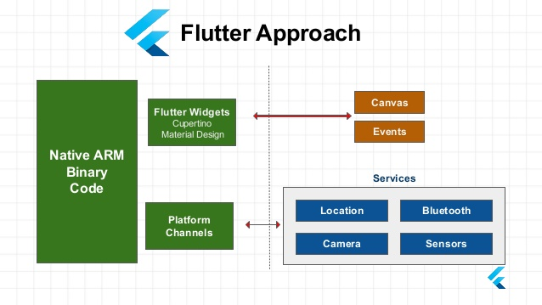
Dano Boot Camp
www.danobootcamp.com

Slide 11
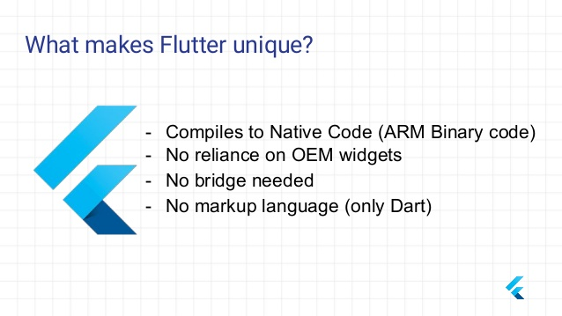
Dano Boot Camp
www.danobootcamp.com

Slide 12
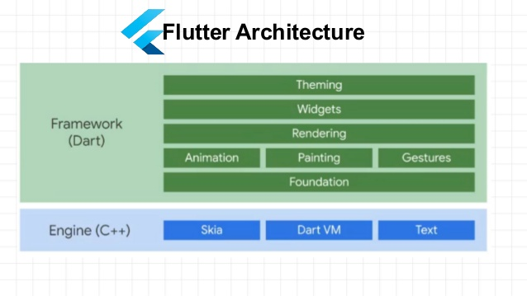
Dano Boot Camp
www.danobootcamp.com

Slide 13
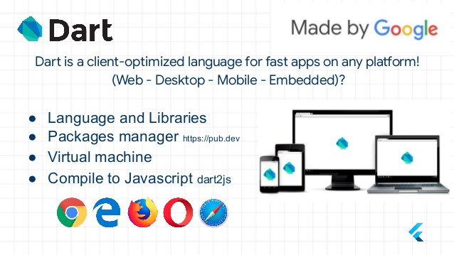
Dano Boot Camp
www.danobootcamp.com

Slide 14
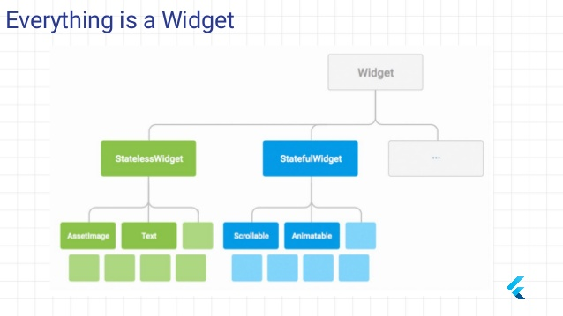
Dano Boot Camp
www.danobootcamp.com

Slide 15
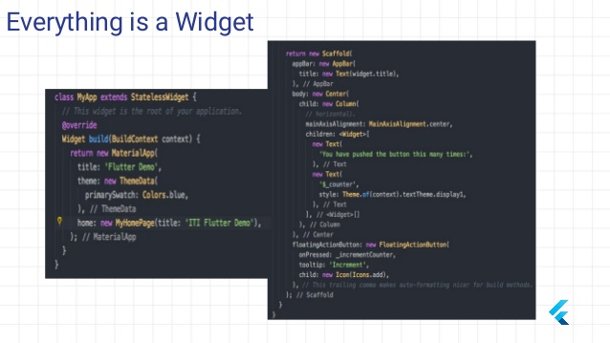
Dano Boot Camp
www.danobootcamp.com

Slide 16
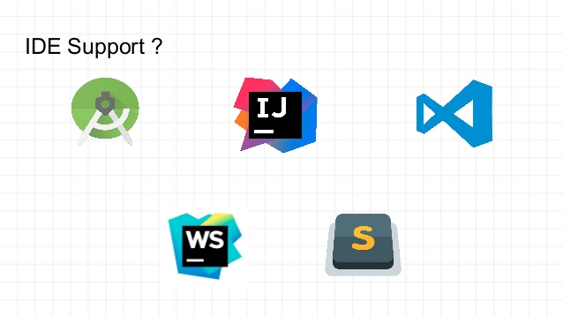
Dano Boot Camp
www.danobootcamp.com

Slide 17
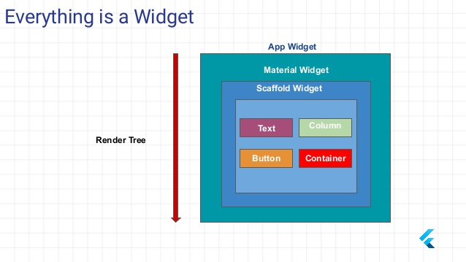
Dano Boot Camp
www.danobootcamp.com

Slide 18
END OF
DAY 1
Dano Boot Camp
www.danobootcamp.com

